Slide 1




CSE 543
Information Assurance and Security
Blockchain and IA Applications
Professor Stephen S. Yau
Spring 2022

Slide 2
Important Features of Blockchain
Decentralization
Immutability
High Fault Tolerance
High Availability
Transparency
Auditability

Slide 3
Major Applications of Blockchain
Software development
Supply chain
Electronic voting
Cloud computing
Internet of Things
Finances
Healthcare
Smart city
…

Slide 4
What Is a Blockchain?
A sequence of blocks, in which each block consists of a header and body, and the blocks are linked by storing the previous block’s hash in the current block header
The first block in blockchain is called genesis block

Slide 5
Genesis Block
cryptographic hash function
Consensus Model
Target Hash number
Time Stamp
0 (PREVIOUS BLOCK’S HASH)

Slide 6
Cryptography in Blockchain
Hashing is a process using a one-way cryptographic function to generate a digest of fixed size from a string of input text, such as SHA256 and Scrypt.
Digital Signatures for source verification
Asymmetric Cryptography
In blockchain, private keys are used to digitally sign the records in block body, and public keys are used to verify signatures

Slide 7
Consensus in Blockchain
A means for majority of the nodes* to reach an agreement before adding validated blocks to the blockchain.
Two consensus models used in blockchain: Proof of Work, and Proof of Stake.

Slide 8
Blockchain Network
Blockchain Network is a peer-to-peer network
Each node (peer) has the following functions:
Store a part of the blockchain
Store the entire copy of blockchain
Generate and validate blocks being added to the blockchain
For nodes to actively participate in a blockchain network, they must be always connected to the network
The nodes that generate new blocks are called miners

Slide 9
*Consensus in Blockchain (Cont.)
Proof of Work:
A block generated by a miner is accepted, when it shows proof of spending a pre-determined amount of computational resources in generating the block. In case of bitcoin, the nodes are required to solve the cryptographic problem of finding a hash with predetermined requirements.
Proof of Stake
The miner which creates a block is chosen randomly based on what is at stake by the miner
For example, the wealth of the miner could be at stake

Slide 10
Target Hash In Genesis Block
Difficulty level (from 0 to 2^256) set in genesis block
When a new block is added to a blockchain, the hash number Hn of the new block is computed with the input as block header of the new block:
if Hn < Target Hash:
add new block to blockchain
else:
reject new block

Slide 11
Timestamp
Timestamp
The current time (in seconds) in universal time since January 1, 1970 when the block is created.

Slide 12
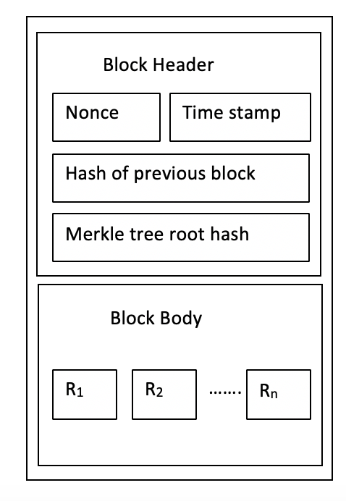
Block structure

Slide 13
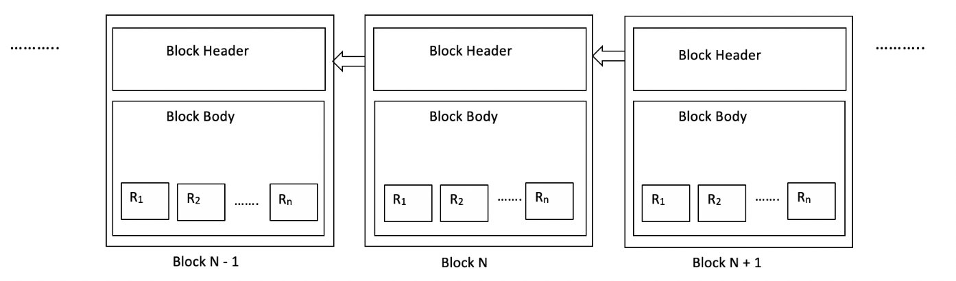
Blockchain Structure

Slide 14
Block Structure in Blockchain
Header
Previous block’s hash
Merkle tree root hash
Timestamp
Nonce
Body
Records
Validated healthcare records
Financial records (e.g. Bitcoin Transactions)

Slide 15
Header
Previous block’s hash
Calculated as Hash (Merkle root hash | Previous block hash | Timestamp | Nonce)
Merkle tree root hash
Created by repeatedly hashing pairs of records in block body until there is only one hash left. This hash is called Merkle root tree hash
Each leaf node stores transaction record from block body
Nonce (Number Only used Once )
A random number that meets the requirements of a target hash.

Slide 16
Smart Contracts
An interactive computer program that defines transaction protocol
Includes the high level terms of a contract of an agreement
Automatically executed in blockchain

Slide 17
Smart Contracts Creation
Two Phases:
Initialization
Initialize agreement with actionable clauses and properties
2. Execution methods
Implement methods to handle actionable clauses

Slide 18
A Smart Contracts Example
Client and Tasker agree on blockchain platform
Client creates and deploys smart contract on blockchain platform with agreement clause(s)
Tasker performs task and provides the result to smart contract
Smart contract automatically verifies the result against agreement clauses
Smart contract automatically triggers execution action in the agreement on blockchain platform.
Reference: https://rubygarage.org/blog/ethereum-smart-contract-tutorial

Slide 19
Types of Blockchains
Public (Permissionless)
Participation/access not restricted to any nodes
Anyone with an Internet connection can be part of this blockchain
Private (Permissioned)
Under administrative control of an entity/organization, or a closed group
Does not require expensive mining process
Consortium
Combination of several blockchains

Slide 20
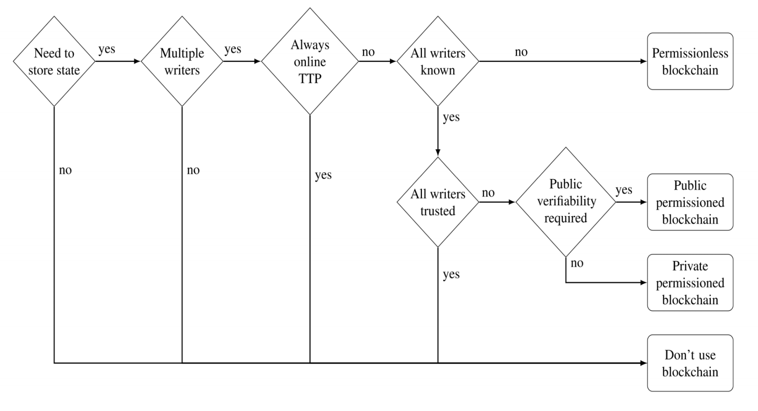
Is blockchain suitable for your application?
Public Blockchain
Private Blockchain
Reference: Meng, W., Tischhauser, E.W., Wang, Q., Wang, Y. and Han, J., 2018. When intrusion detection meets blockchain technology: a review. Ieee Access, 6, pp.10179-10188.​

Slide 21
Popular Blockchain Platforms
Hyperledger (https://www.hyperledger.org/)
Ethereum (https://www.ethereum.org/)

Slide 22
Challenges
Scalability
All the active nodes must have entire copy of blockchain which is a huge storage requirement
High computational resource requirements
Proof of Work consensus algorithms require significant amount of computation power to calculate hash of block
51% attack
If a group of miner can control more than half of blockchain network’s computational resources, this will undermine the major features of blockchain

Slide 23
References for ML and IA Applications
Zheng, Zibin, et al. "An overview of blockchain technology: architecture, consensus, and future trends." 2017 IEEE International Congress on Big Data (BigData Congress). IEEE, 2017.
Meng, W., Tischhauser, E.W., Wang, Q., Wang, Y. and Han, J., 2018. When intrusion detection meets blockchain technology: a review. 10.1109/ACCESS.2018.2799854 https://ieeexplore.ieee.org/document/8274922. ​
M. Conti et. al, “A Survey on Security and Privacy Issues of Bitcoin”, ArXiv: DOI:10.1109/COMST.2018.2842460

Slide 24
References for Blockchain and IA Applications
P. Zhang et al, “FHIRChain: Applying Blockchain to Securely and Scalable Share Clinical Data”, in J. Comp. & Struct. Biotechnology, 2018.
Zhu, H., & Zhang, Y. (2012). Collaborative testing of web services. IEEE Transactions on Services Computing, 5(1), 116–130. https://doi.org/10.1109/TSC.2010.54
Stephen S. Yau and Jinal S. Patel School of Computing, Informatics, and Decision Systems Engineering Arizona State University “A Blockchain-based Testing Approach for Collaborative Software Development “
Stephen S. Yau and Jinal S. Patel School of Computing, Informatics, and Decision Systems Engineering Arizona State University “Application of Blockchain for Trusted Coordination in Collaborative Software Development “

